Slide 1
Digital Design with HDL (2019-2020 )EcE-41021
Dr Tin Thet Nwe

Slide 2
Digital Hardware
logic circuits
until 1960s,constructed such as few transistors and resistors
integrated circuits
to place a number of transistors, and thus an entire circuit, on a single chip, silicon wafer
microprocessor
a few million transistors
more than 10 million transistors
Moore’s law

Slide 3
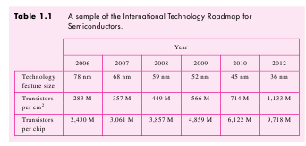

Slide 4
Three main types of chips
Standard chips
Programmable Logic Devices
small amount of circuitry, simple function, fixed ,space on PCBs, low functionality
Custom-Designed Chips
configured by user,
reprogrmmed,consume chip area
eg,FPGA
specific task,
amount of time to order,eg ASICs

Slide 5
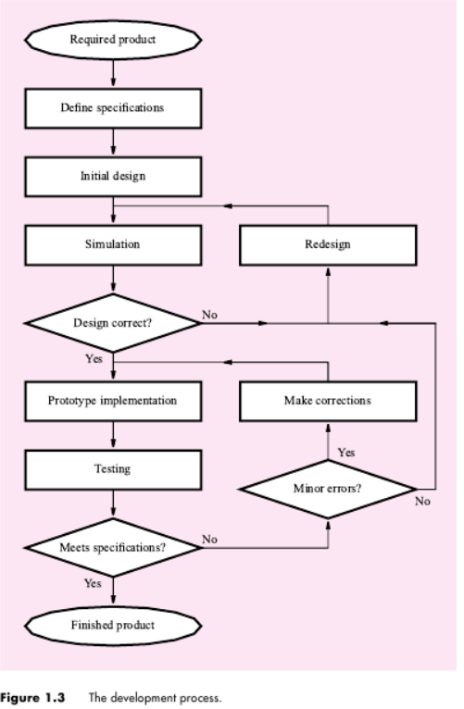

Slide 6
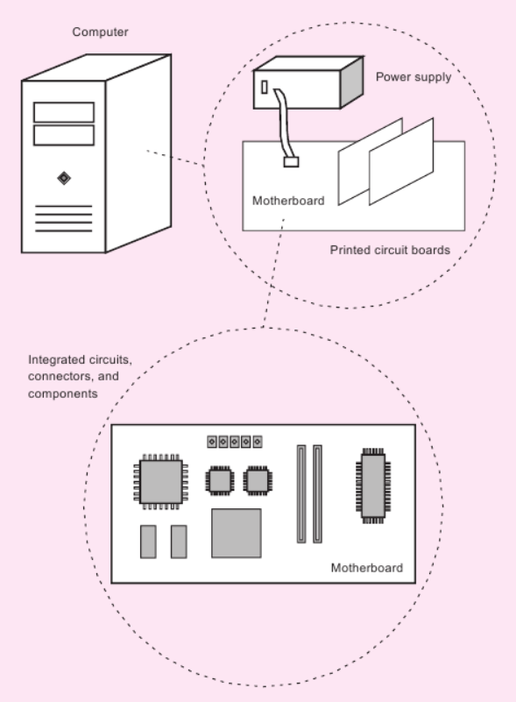
Structure of Typical computer

Slide 7
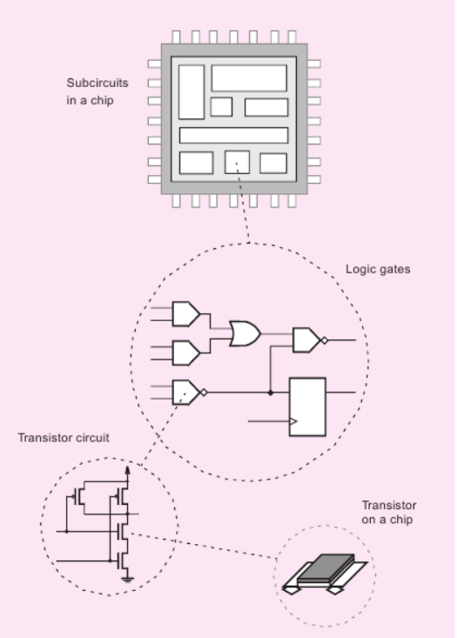
Structure of Integrated Circuit Chip

Slide 8
Theory and Practice
Modern design of logic circuits depends heavily on CAD tools
CAD tools ,not only to design incredibly complex circuits but also to design work much simpler
CAD tools perform the automatic tasks of optimizing a logic circuit to meet particular design objectives, but the designer has to give the original description of the logic circuit.
Computer-based tools, produce good digital hardware designs, only when employed by a designer, thoroughly understands the nature of logic circuits.

